Slide 1
FEBRUARY 26, 2022

Slide 2
Is California Housing policy helping California residents?

Slide 3
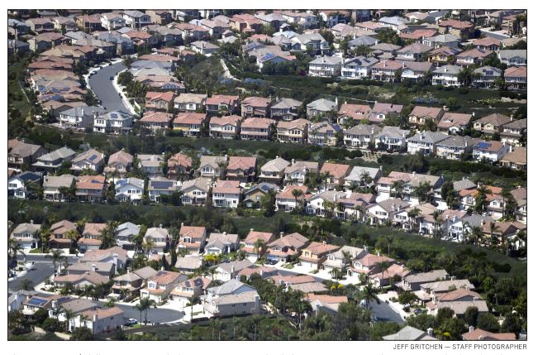
Housing supply is not the problem

Slide 4
Overall state and local housing supply does not appear to be materially out of balance
California Census Data shows:
2.88 people per housing unit in 1960
2.74 people per housing unit in 2020
We had no supply OR affordability issues in 1960

Slide 5
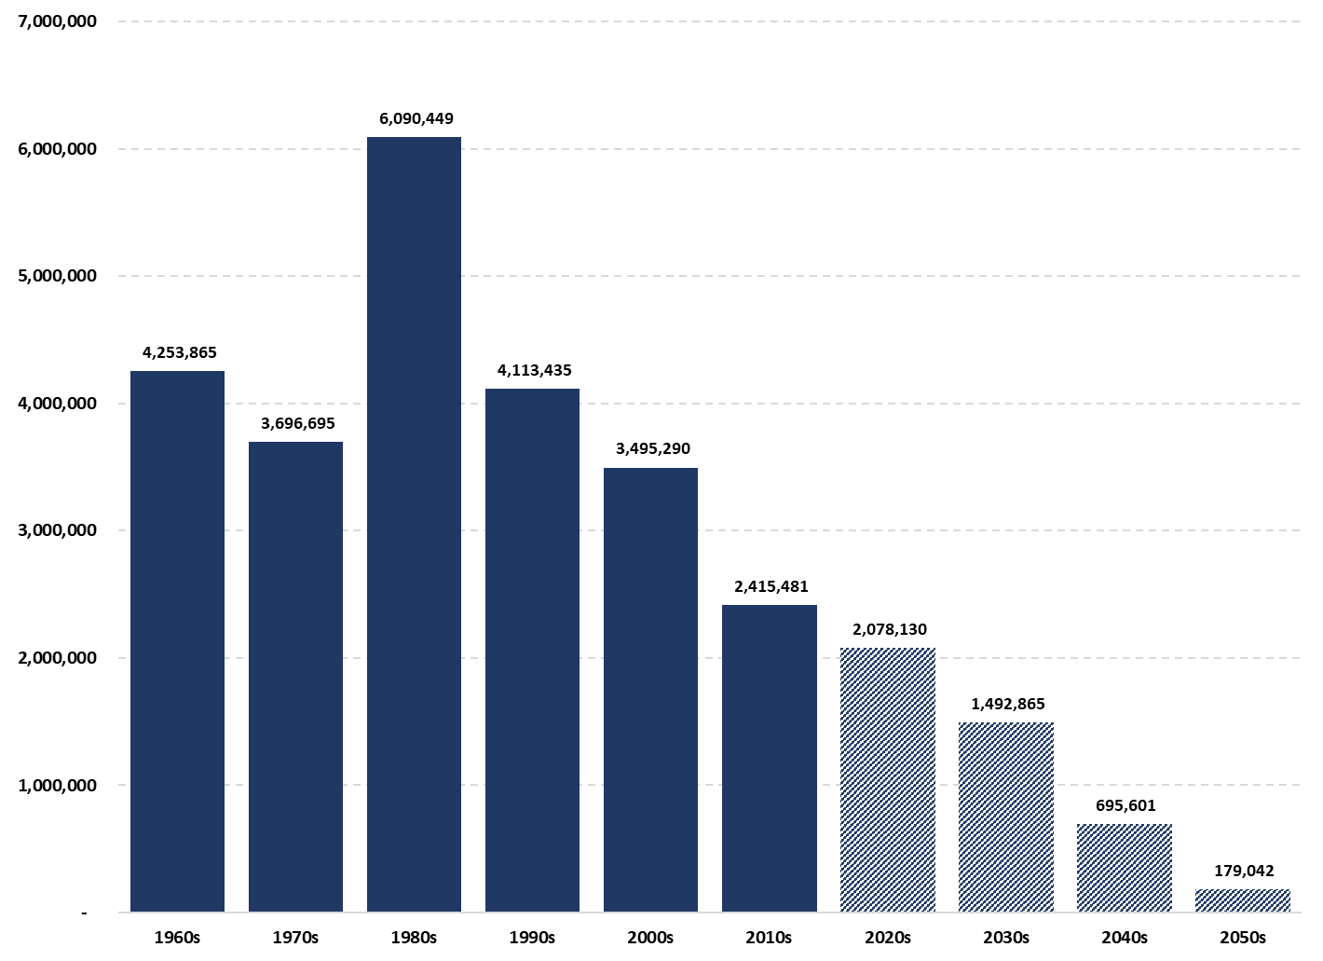
California’s Population Growth Is Experiencing A Historic Deceleration…
The forecasts are very optimistic - there is no support for the 2020s growth to be 86% of the 2010s…
Since 2019, the implied 10-year population growth rate has fluctuated from +0.4 million to (1.8) million
Sources:
US Census
California Department of Finance (DoF)
Actual (Census)
Forecast (CA DoF)

Slide 6
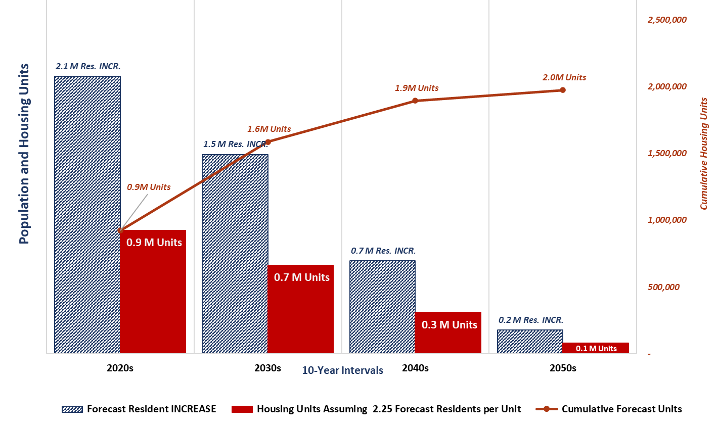
Even the highly optimistic growth scenario indicates the housing supply over the medium and long term is entirely sufficient without RHNA…
The existing 2021 homebuilding start rate of over 117,000 units per year (1.2m per decade) suggests supply will easily meet demand
6th Cycle RHNA
7th Cycle RHNA
8th Cycle RHNA
9th Cycle RHNA
2,442,254 Units
+ ? Units
+ ? Units
+ ? Units
Source:
California Department of Finance. Demographic Research Unit, July 2021
Note:
Housing units estimated at conservative 2.50 vs 2021 CA DoF estimate of 2.74

Slide 7
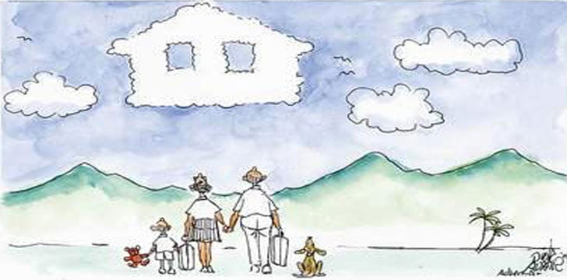
Housing affordability is the problem
Source: KADVACORP

Slide 8
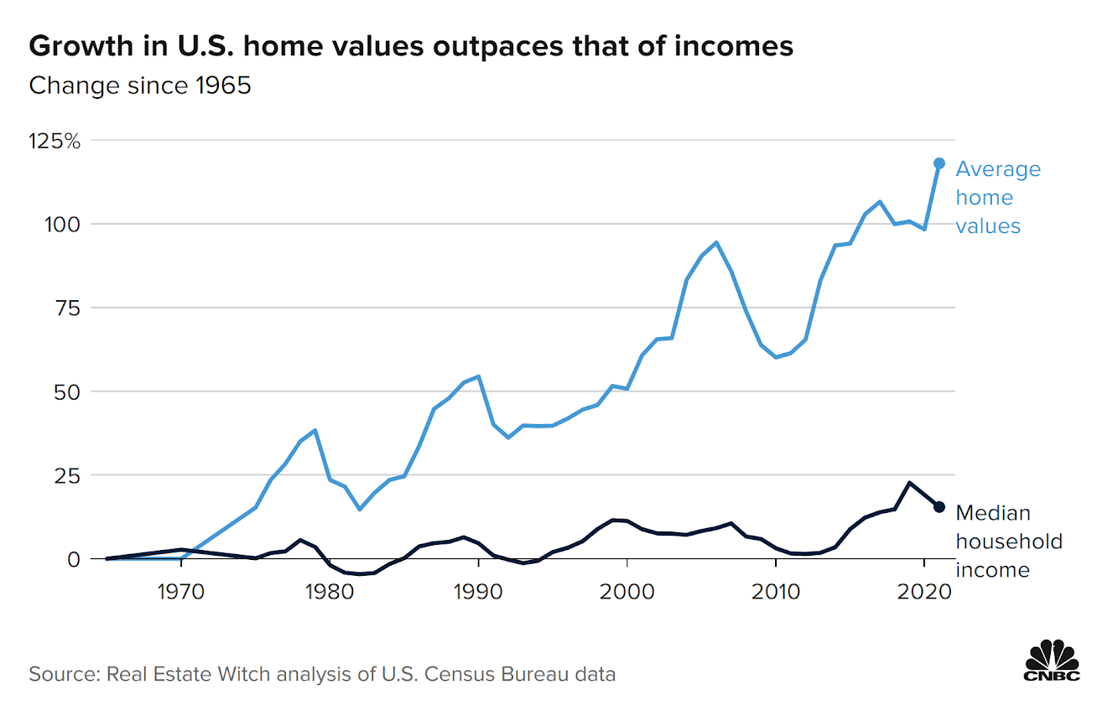
What has caused
this disparity?

Slide 9
Average house-price-to-income ratio:
Recommended ratio = 2.6
Average U.S.A. ratio today = 5.4
Average California ratio today = 8.7
Average Los Angeles ratio today = 14.7
Source: Real Estate Witch House Price to Income Ratio Study, 2021
Los Angeles, 2018 SCAG

Slide 10
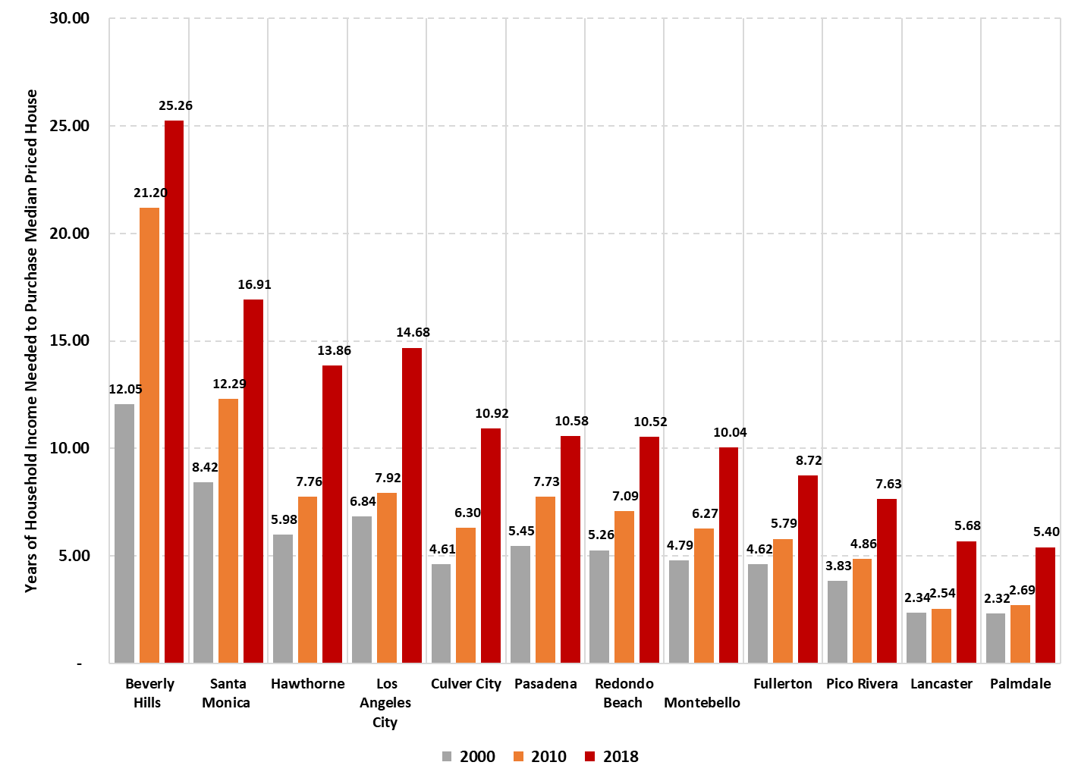
Southern California illustrates the impact across a high-demand region
Scale of the increases is entirely out of scale of wage-based bidding
Residential appreciation trends have rippled through the SoCal area
Affordable locations impacted by migration from higher income residents
Non-wage Capital Higher-income Economic Migration
Data Source: SCAG 2019 City Profiles
https://scag.ca.gov/data-tools-local-profiles

Slide 11
Non-wage capital, especially institutional and private equity, is entering the single-family market in unprecedented amounts.
California housing costs have subsequently inflated at such a rate that housing costs have completely decoupled from their historical wage-based income basis.

Slide 12
THIS IS NON-WAGE CAPITAL
Institutional investors (traded funds, pension funds)
Private equity investors
International Investors – entities and individuals
Equity-based individual compensation in Tech and Entertainment (likely not captured in median Income measures)

Slide 13
THIS IS WHY FAMILIES
CANNOT AFFORD A HOME
Lennar is launching a $4B platform that will buy single-family homes to turn into rentals reducing housing stock for middle class homeowner
California State Teachers’ Retirement System formed a $1B joint venture to invest in the build-to-rent sector
Institutional buyers are flooding the single family market dropping a record $77B on homes in the past 6 months.

Slide 14
“73% of houses permitted in 2020 statewide were affordable only to high income households.”
Report card (5th Cycle RHNA) shows how badly California is failing on affordable housing; LA Daily News 11-28-2021
“Only 1,050 homes permitted statewide last year were considered affordable for purchase by people who live in the State’s 5.3 million low and very low-income households.”
Report card (5th Cycle RHNA) shows how badly California is failing on affordable housing; LA Daily News 11-28-2021

Slide 15
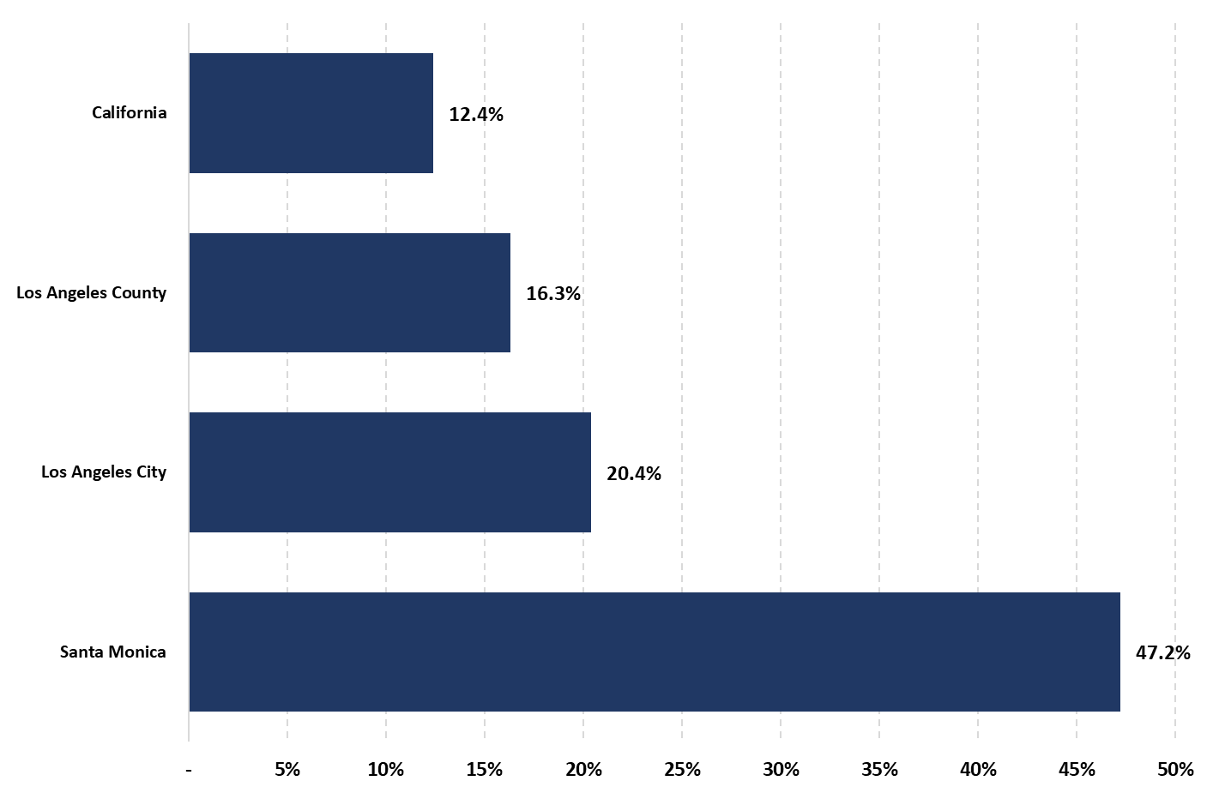
With housing becoming a corporate investment asset,
land value appreciation is what matters...
INVESTORS CAN AND DO LEAVE PROPERTIES VACANT
VACANCY RATES ON CAPACITY ADDED SINCE 1970
Data Source: 2020 US Census

Slide 16
Is RHNA Really About Providing The Needed
AFFORDABLE HOUSING?

Slide 17
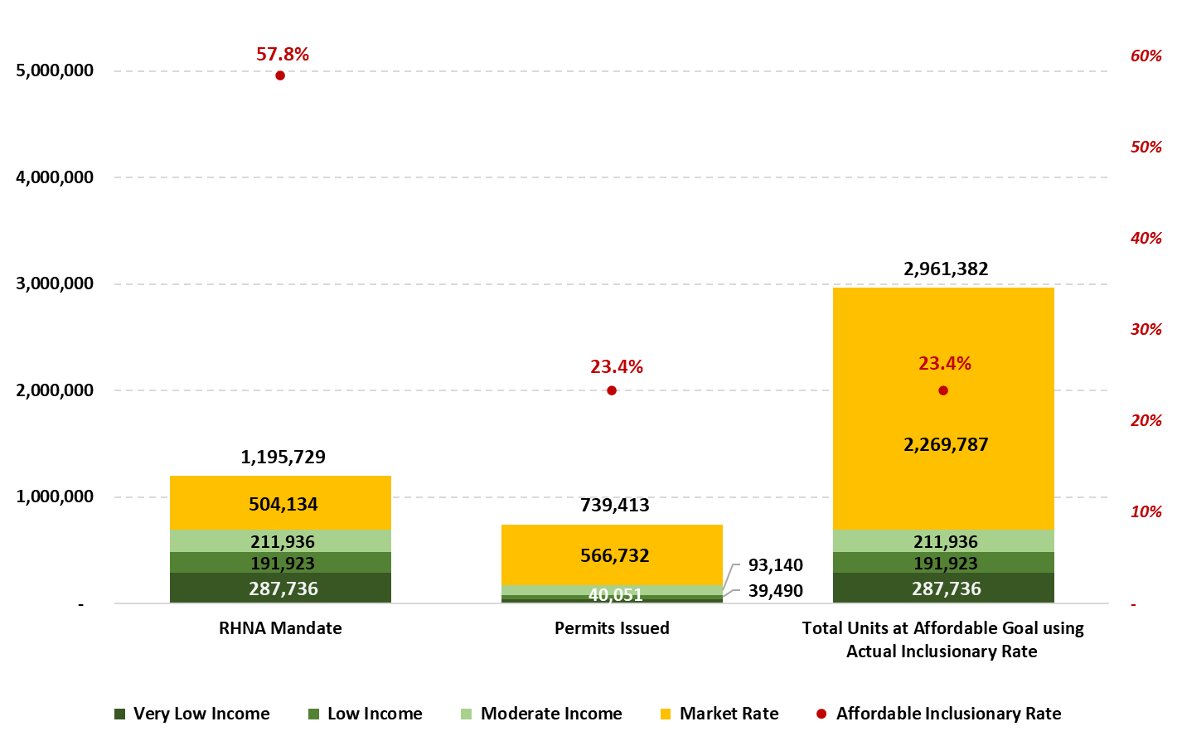
The stated 5th Cycle RHNA Mandate required a 58% Affordable unit to total unit ratio which was economically infeasible without direct subsidies.
5th Cycle Statewide RHNA Units
671,750
671,750
172,681
Data Sources:
RHNA Mandate: CA HCD https://www.hcd.ca.gov/community-development/rhna/index.shtml#6thcycle
Permits: https://www.dailynews.com/2021/11/28/report-card-shows-how-badly-california-is-failing-on-affordable-housing/

Slide 18
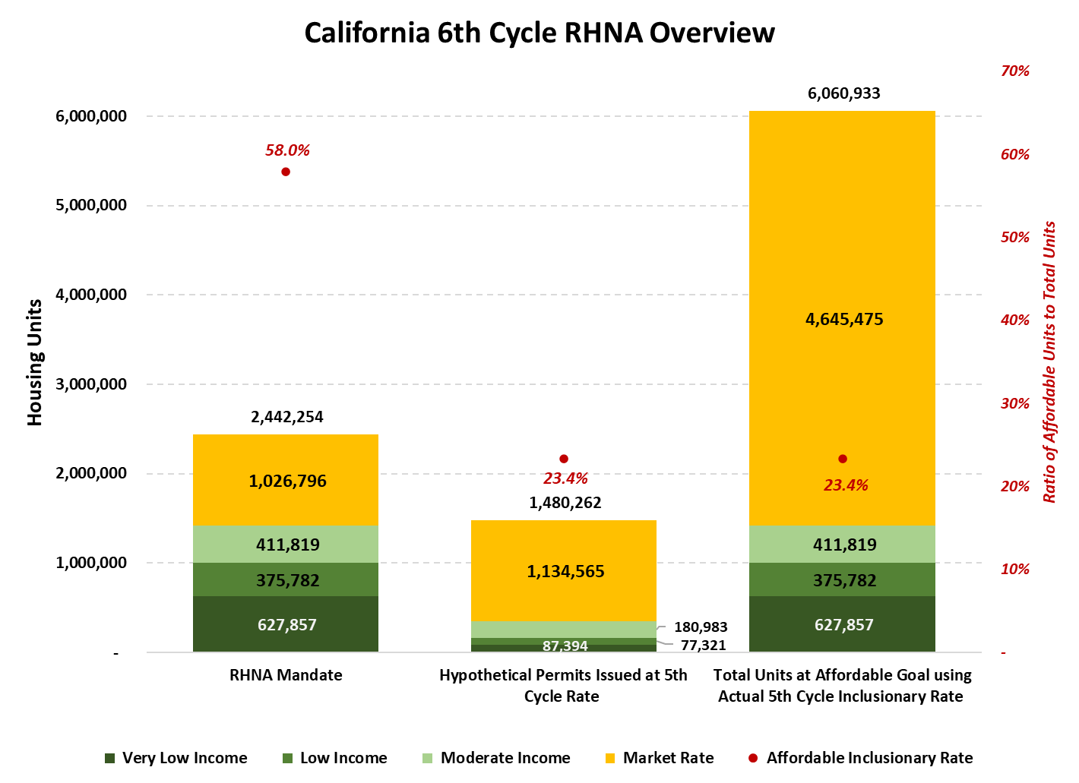
Overproduction of Market Rate units in the 6th Cycle RHNA will accelerate!
RHNA targets were DOUBLED in the 6th Cycle to coincide with the implementation of ministerial approvals and upzoning…
6th Cycle Statewide RHNA Units
1,319,056
345,698
Data Sources:
RHNA Mandate: CA HCD https://www.hcd.ca.gov/community-development/rhna/index.shtml#6thcycle

Slide 19
RENTS ARE IMPACTED BY HOUSING PURCHASE COST ESCALATION
The Dallas Federal Reserve Bank concluded that single family home prices were a leading indicator of an area’s rental prices with a two-year lag. Consequently...
Policies that increase single family housing costs (e.g., upzoning) impact renters!

Slide 20
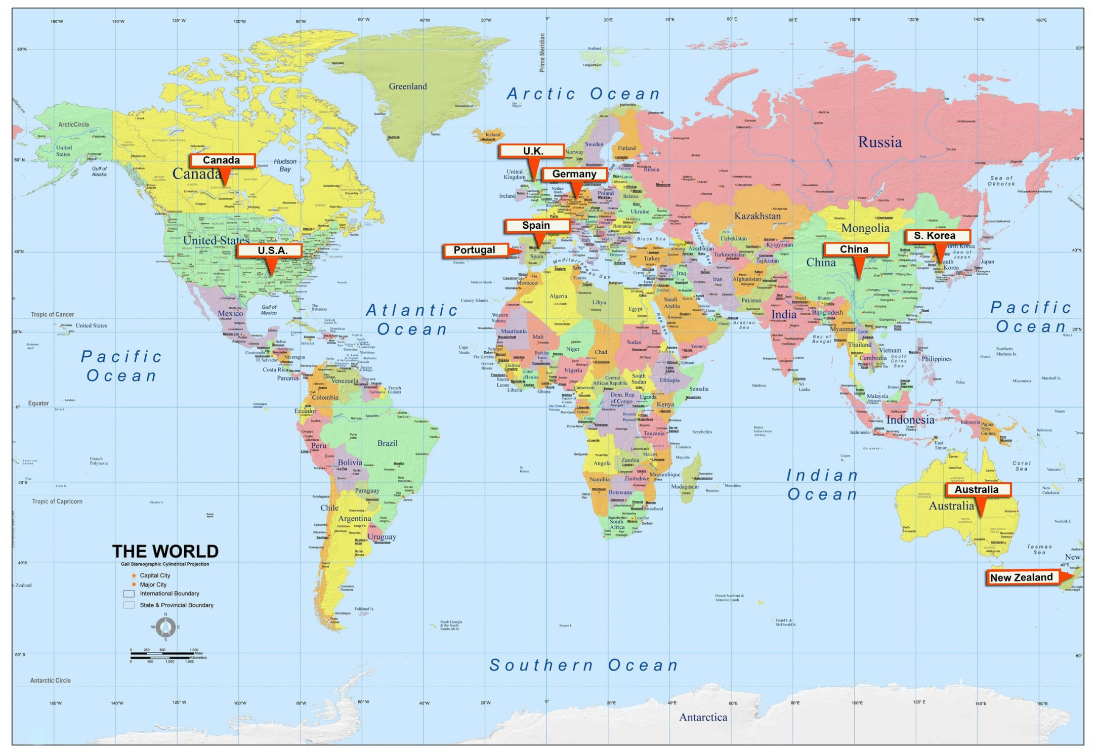
Affordable housing crisis is World-wide
“Across the world, families are being outbid on homes, and tenants struggle with steep rent increases and evictions. Homelessness is now a global problem, even in countries with strong social support safety nets. Non wage capital flooding into the housing markets is driving prices higher. Seemingly logical solutions like increasing housing supply and density only exacerbate the problem.” Sharon Byrne
Countries are scrambling to legislate against corporate take-over of their housing

Slide 21
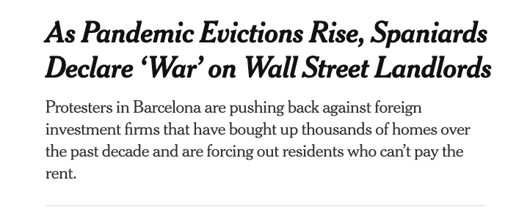
Profitization Pushes People Out.
Homelessness. 10m estimated globally
Speculation: institutional investors acquiring vast amounts of homes – Spain, UK, China, Germany, US, Canada
Rapidly Rising Housing costs: S Korea, Australia, NZ, UK, Canada (400% in 20 years).
Displacement: “golden visas”, apartments being taken over, tenants evicted, corporate homes left vacant, AirBNB / STR, social housing converting to market rate
Vacant foreign-owned homes, while locals can’t find a home

Slide 22
World Governments’ Responses:
Legislation | Initiative Target | Territory
Housing As A Human Right | Housing Access | New Zealand; Spain; France; Scotland; South Africa; Canada
End blind-bidding | Affordability | Canada
Ban foreign investment in homes (2 years) | Affordability | Canada
Limiting ‘golden visas’ to avoid displacement | Displacement, Affordability | Portugal; UK
Expropriation of corporate-owned homes | Affordability, Supply | Barcelona; Berlin
Vacancy and second-home taxes | Supply | Barcelona; Oakland, CA
Municipal rental inventory tracking system | Supply | Santa Barbara, CA
Eviction restrictions on newly purchased buildings | Displacement, Affordability | Amsterdam
Restricting financing that fuels speculation | Affordability | China
Adaptive Reuse | Supply | Seoul, South Korea

Slide 23
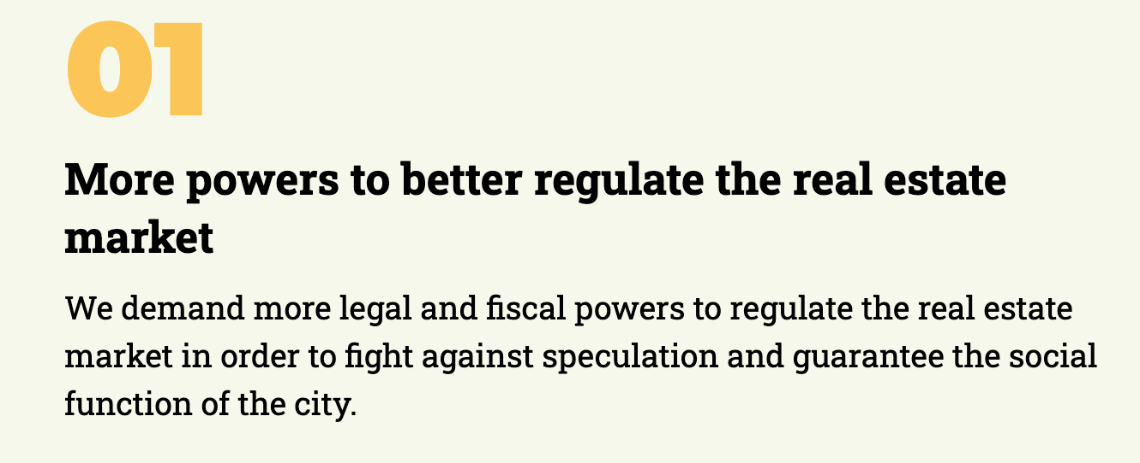
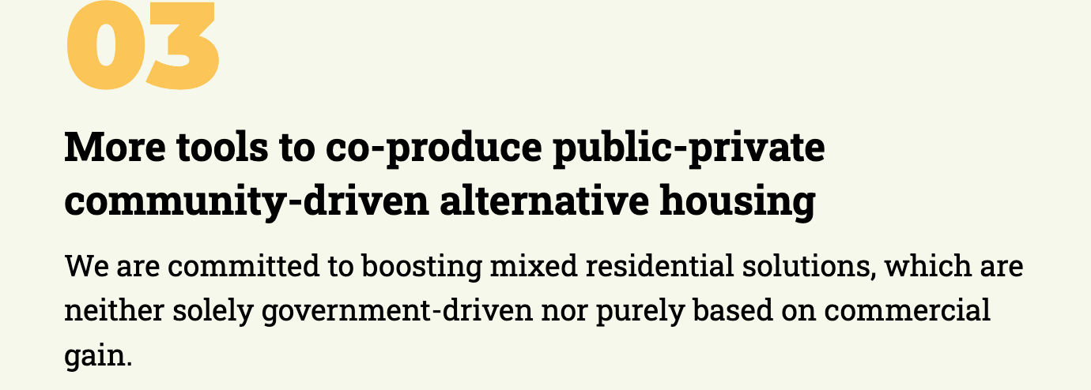
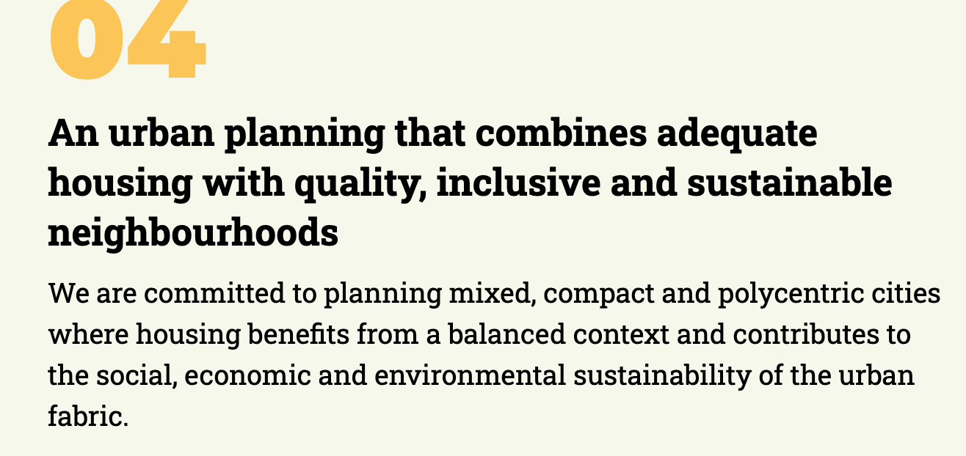
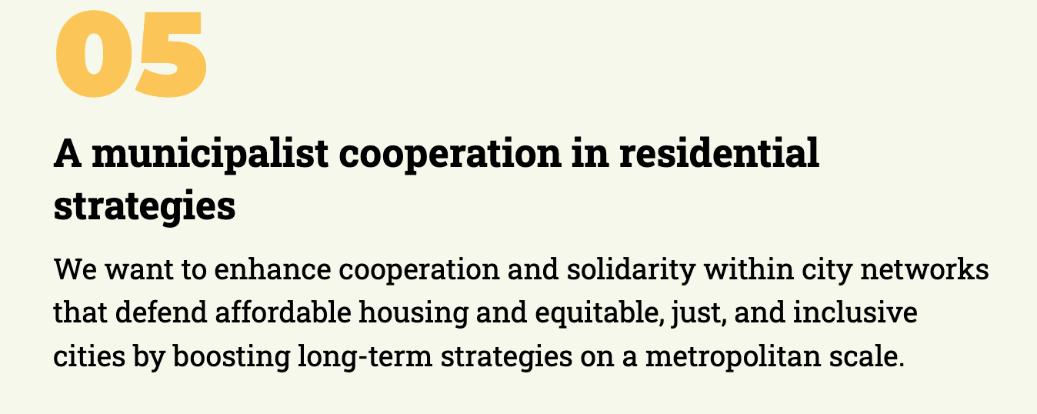
A Bigger Vision:

Slide 24
California Focus: Deregulate and build more (luxury)
.
LEGISLATION
Demonize and override
‘NIMBY’ Cities, SFR Neighborhoods
CoC, Housing Justice

Slide 25
CA’s supply-side-only strategy feeds the speculator
Build more, they’ll just eat more. Net supply added will <100% of what gets built.
Speculation is the problem.
So why not give our local governments tools to deal with that?
Vacation Rentals
Pacaso
Institutional Investors
Vacant homes
Foreign owned property

Slide 26
So, while proactive positive steps are being taken internationally to address the AFFORDABILITY problem…
CALIFORNIA
has chosen to
ACTUALLY, MAKE IT WORSE…

Slide 27
All the prior housing bills like SB35 SB9 and SB10
will not solve the affordable housing problems.
Neither will 2022 bills like these:
AB 1910: Public Golf Courses into Housing
AB 2053: Social Housing Act: California Housing Authority
AB 2097: Parking Requirements

Slide 28
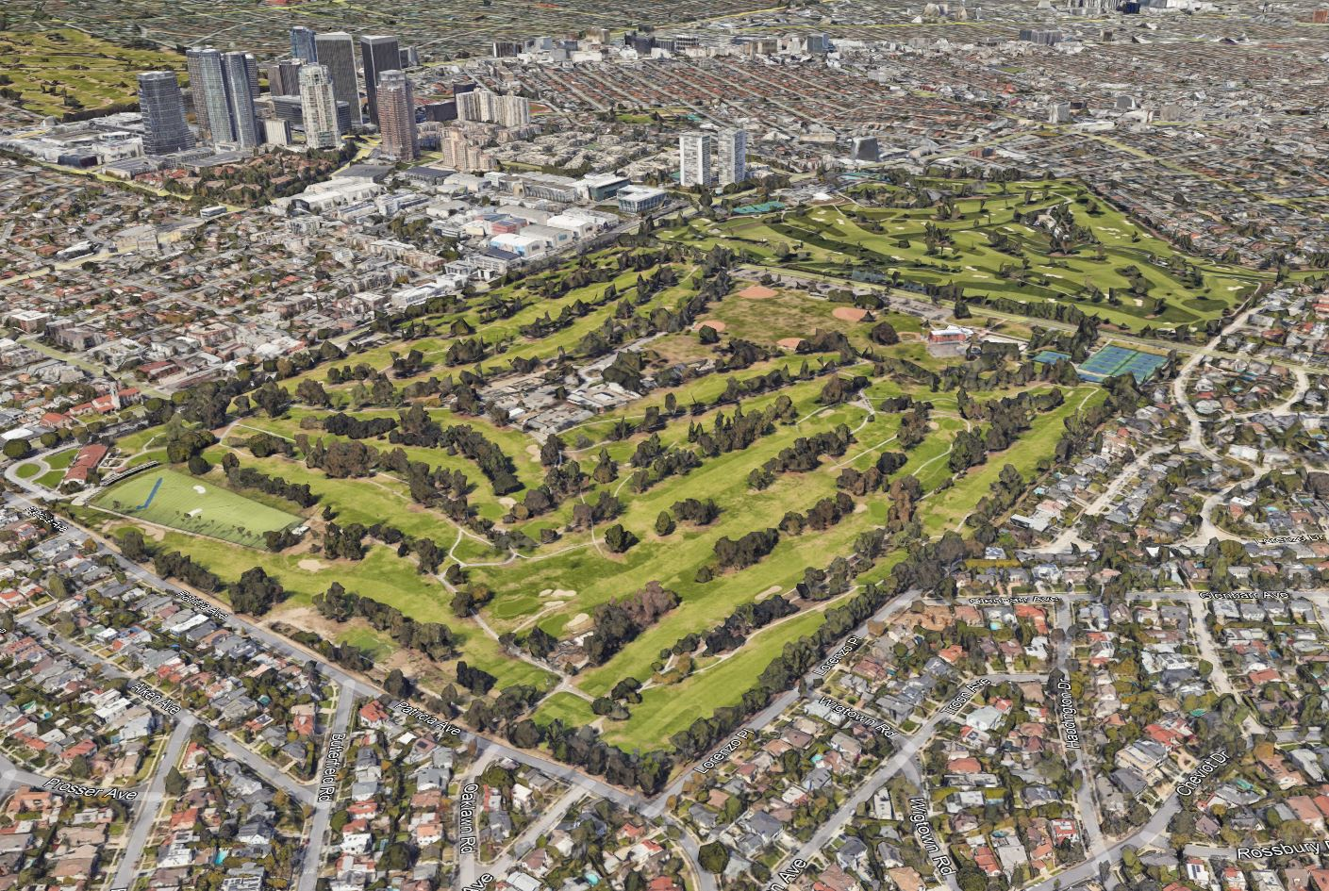
AB 1910
Converting public golf couses and other public recreational areas into housing is inequitable and will have a negative environmental impact.

Slide 29
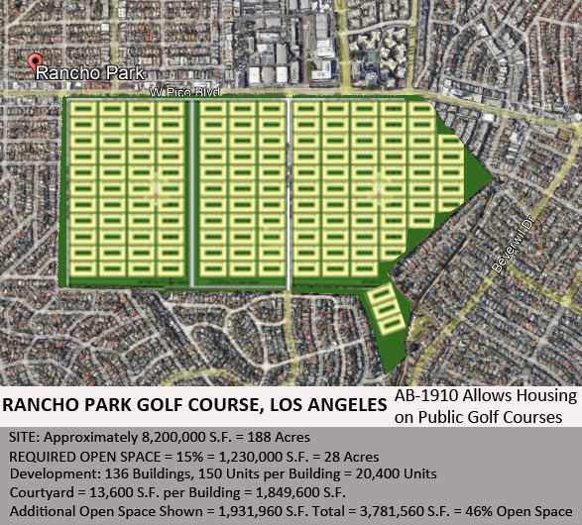
CONCEPTUALLY
AB 1910 could allow as many as 20,000 homes on this site.
A speculator’s dream!
Requiring only 15% open space, an insufficient amount of affordable housing and would result in a huge adverse environmental impact.

Slide 30
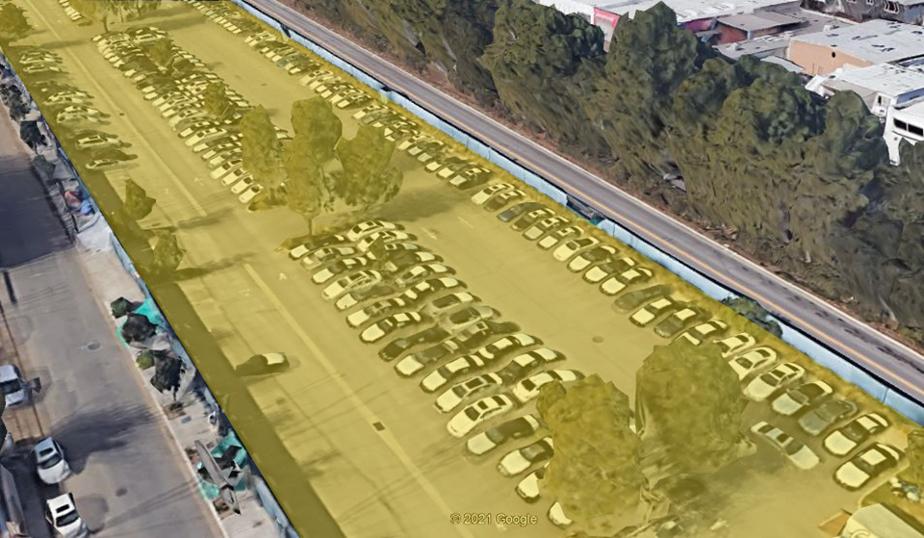
Bus Line Parking
New Dealership Cars Stored
On Publicly Owned Land
Unhoused Encampment
On Publicly Owned Land
But, public lands currently used for parking can be built upon for mixed income housing while still supplying public parking.

Slide 31
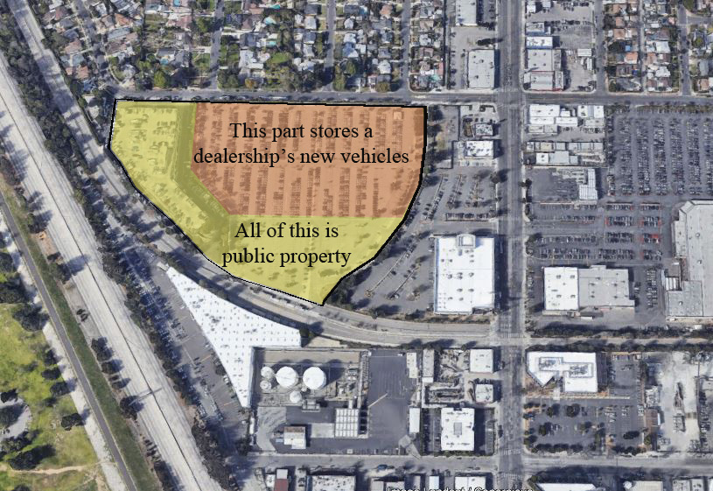
Another Public Parking Lot storing dealership cars.
We do not need to destroy public recreational sites for housing.

Slide 32
AB 2053 Social Housing Act
New State agency can take over underutilized parcels for development based on meeting over inflated RHNA numbers.
Publicly developed housing as proposed here will replicate the failures of current private developers who have to over build market-rate housing to reach an inadequate number of affordable units. We will never catch up with need.
Public housing policy needs to state the percentage of affordable units, must comply with local zoning and design guidelines in an effort to create equitably designed communities. Needs to be state funded and cannot use eminent domain of private property without very strict guidelines.

Slide 33
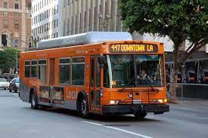
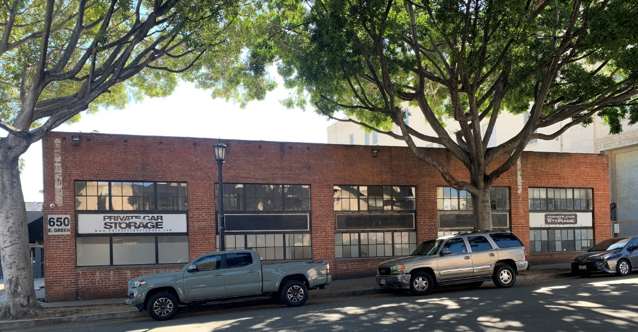
AB 2097 Parking Requirements
No parking required in residential, commercial or any other developments with ½ mile of public transit.
Transportation tied to a bus line is not equitable and limits options for education, work and social outings.
This is the future for those who can afford it.
Reducing the cost of development will not lower rents.
It only increases profits.

Slide 34
AB 2097 Parking Requirements
This bill removes another tool for adding affordable housing. Reduction in parking minimums is one of the major incentives for developers to build affordable housing.
Eliminating parking and therefore cars, tying families to phantom mass transit limiting their ability to access jobs of their choice, schools of their choice, recreational opportunities and the ability to visit friends and family is inequitable and immoral.
First the community needs to establish a viable mass transit system and/or supply community parking with free shuttle service.

Slide 35
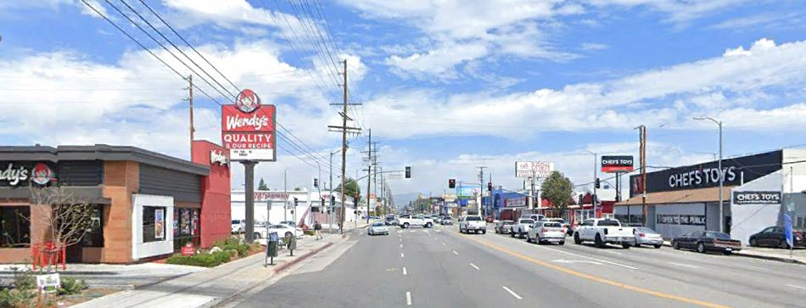
California should pursue and incentivize building affordable, equitable, mixed income housing projects on underutilized commercial corridors, repurposing of big box retail and adaptive reuse of office buildings. This would result in a significant amount of housing where infrastructure already exists to handle development.

Slide 36
We support policies that incentivize the development of equitable, affordable housing
1.) Policies that do not allow speculators/investors from outbidding working families for housing.
2.) Policies that do not eliminate parking requirements that hurt working class families by tying them to phantom mass transit limiting their ability to access jobs of their choice, schools of their choice and ability to visit family.
3.) Policies that correct RHNA methodology so that the overbuilding of market rate housing stops and the focus shifts to adding more affordable housing.
4.) Policies that address vacancy rates created by speculative investments and reduce the available housing supply.

Slide 37
5.) Policies that protect open space, trees, permeable surfaces and public recreational areas.
6.) Policies that mandate affordable housing requirements on all residential developments including single family zones.
7.) Policies that protect older, more affordable residential stock in single family and multi-family housing.
8.) Policies that develop opportunities for first time buyers to enter the housing market.
9.) Policies that reinstate redevelopment funding for cities to fund affordable housing.

Slide 38
Presentation by:
Maria Pavlou Kalban
Cindy Chvatal
Sharon Byrne
Marc Verville
Jeffrey Kalban
mpkalban@gmail.com
818 469 4796
unitedneighbors.net

